Slide 1
Failure Mode & Effect Analysis
U5 – Analyse
E3 – Analytical Methods
The element ‘Analytical Methods’ describes the tools that can be used for risk analysis, root cause analysis and waste identification.
Yellow Belt
Notes:
Welcome to this Lean Six Sigma Academy Yellow Belt training module.

Slide 2
Failure Mode & Effect Analysis
Basic principle
Leads to
Cause
Failure Mode
Can result in
Effect
Thanks to
Leads to
No time for patient
Patient waiting
Can result in
Increasing risks
Thanks to
Notes:
The basic principles upon which the construction of an FMEA is based are pictured here. Let’s first look at all of the potential failure modes in each process step. For each failure mode, we can estimate the effect the failure mode has on the customer and how important this is for this customer. We then look at the root cause for this failure mode. If we know the cause of the failure mode, we can take the right action to remove or reduce the risk of the failure mode.

Slide 3
Failure Mode & Effect Analysis
Where do risks come from?
Potential safety hazards
Poor procedures & protocols
Unclear client expectations
Poor process capability
Cumulative risk
Wrong material
Unclear work objectives
Unrealistic expectations/ goals
Equipment reliability
Unclear information
D. H. Stamatis, FMEA:FMEA from Theory to Practice, Quality Press, 1995
Notes:
The risks that occur during process and product development are very diverse in nature. In this overview we show some of the potential risks, but in reality there are many more. It is important for a project team to make an extensive overview of all the risks and to continue to maintain this during the project or process development. This is important because actions should be taken in advance to reduce risks and because new risks will potentially emerge over time. The purpose is to reduce the cumulative risk.

Slide 4
Failure Mode & Effect Analysis
Why is FMEA important?
FMEA is a structured approach to:
  Identify potential failure modes early and to eliminate their root causes
  Reduce the severity of an effect if the root cause can not be eliminated
  Reduce the frequency of occurring failure modes
  Determine which root causes and failure modes to work on first and which improvement activities must be started first
  Increase customer satisfaction by improving the quality, reliability and safety of products
Notes:
The reason to make an FMEA as explained earlier is to signal, in an early stage of a project, the potential failures and to prioritize the most important actions to be taken. If we can’t remove the cause of a certain failure completely, we can try to reduce the severity or reduce the frequency of the problem. The ultimate goal is to increase customer satisfaction, especially because the effect of the failure on the customer is studied. Additional benefits are the improved quality, reliability and safety of the products.

Slide 5
Failure Mode & Effect Analysis
10 steps to construct a FMEA
Input:
Process Step
Severity:
How bad?
Occurrence:
How often?
Detect ability:
How bad?
RPN:
What is the risk?
What could potentially go wrong?
Effect of
the failure
Causes of
the failure
Controls to
detect or prevent
Actions to
lower risk
Notes:
Within the first step of FMEA creation, we describe the different process steps and for each process step, we describe the potential failure modes. We need to describe as many failures that could possibly occur in daily practice. This also includes those failures with a very small risk, but with an important effect on the customer. Safety risks are also included in an FMEA. For each failure mode, the effect on the customer is described and an estimate is made of the severity of the failure mode. The severity is expressed as a value on a scale of 1 to 10. The 1 means that the severity is so low the customer doesn’t care and the 10 stands for a very severe impact on the customer or the safety. Most company’s use a table that indicates an interpretation of each figure on the severity scale.

Slide 6

Failure Mode & Effect Analysis
Potential Failure Mode
  Process Step Failure Mode
  Doctor Order of Medication Wrong drug or dose
  Wrong patient
  Pharmacy Order Entry Wrong drug or dose
  Wrong patient selected on system
  Pharmacy Prep Order Error in dosage/concentration
  Wrong drug selected
  Order Administration to Patient Wrong patient receives drug
  Drug administered at wrong time
123RF Stock Photo
Notes:
The potential failure modes in a workstep must be first identified. For example if a doctor orders medication , he or she may request the wrong dosage.

Slide 7
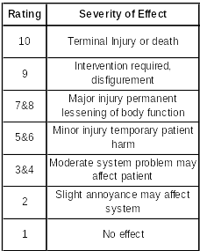
Failure Mode & Effect Analysis
Severity
  Severity of the effect for the customer or severity of the failure
  Safety is very important
  Effect Severity
  Health risk or death 10
  Dose is held and patient delayed 3
Notes:
The severity of the failure mode must be calculated. The team identify for example - in the event of a wrong dosage, what is the effect on the patient and hence the severity. Severity is usually estimated using a table ranking the effects between 1 and 10. 10 is the worst severity resulting in death with 1 being minor or none –no effect.

Slide 8
Failure Mode & Effect Analysis
Occurrence
  The probability/ frequency that a failure mode/ cause will occur. . . which will lead to the effect
  With the current (preventive) controls
  Without detection measures
  Occurrence refers to how frequently the specified failure is expected to occur
  Occurrence can be estimated on the basis of historical data
  For example customer complaints and process know how
Notes:
The occurrence is next calculated. This is the probability or frequency that a failure mode will occur in todays process without any controls or detection methods.

Slide 9

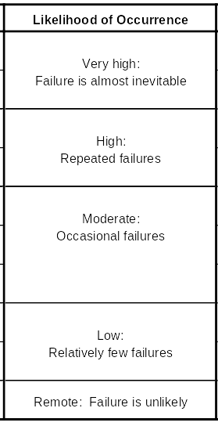
Failure Mode & Effect Analysis
Occurrence
  Can also refer to the frequency of the cases
  of the failure modes
  1 = not likely, 10 = very likely
Notes:
An occurrence rating must be calculated. An occurrence rating of between 1 and 10 can be given. A 10 rating means an issue has a very high chance of occurring whereas an occurrence of 1 means the failure mode is remote or unlikely.

Slide 10
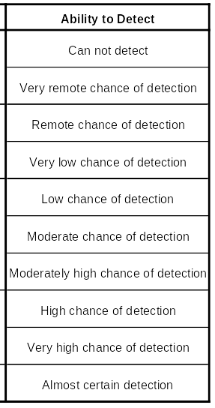

Failure Mode & Effect Analysis
Detection
  Possibility of the control to detect the
  cause or failure mode before the impact
  can occur
  In other words: what is the probability of detecting the failure or cause?
  1 = very likely, 10 = not at all
Notes:
The chance of detection of the failure mode must next be established. In other words what is the probability of detecting the failure or cause?.. The detection rating is also between 1 and 10 with 1 equaling almost certain detection and 10 equaling an impossibility to detect.

Slide 11
Failure Mode & Effect Analysis
Risk priority number (RPN)
  The FMEA output is the RPN = Risk priority number
  RPN is based on information provided by:
    Potential failure modes
    Effects (impact on client/ patient expectations)
    Current possibility of the process to detect the failures
  The RPN is calculated as the product of three quantitative ratings, which are related to the effects, causes, and controls:
RPN = Severity X Occurrence X Detection
Effects
Causes
Controls
Notes:
If we have estimated the values for Severity, Occurrence and Detection, the multiplication of these values is the last step to calculate the RPN or Risk Priority Number. After sorting the matrix by the highest RPN, we can determine which failure modes are the most important modes to improve.

Slide 12
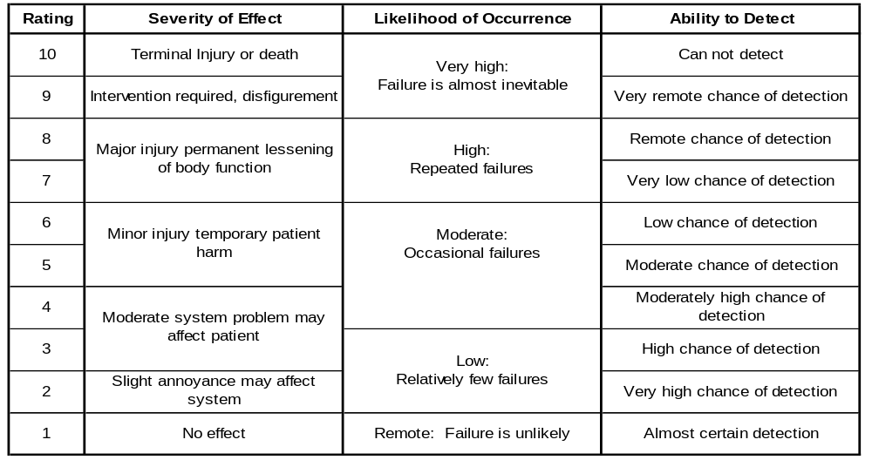
Failure Mode & Effect Analysis
Endresult of FMEA
Notes:
When we have completed the FMEA we will have an RPN based on a quantifiable severity of effect, likelihood of occurrence and an ability to detect.

